Slide 1

Year 6 Residential: 29th September to 1st October 2025

Slide 2

Video link: https://www.youtube.com/watch?v=Cmgj2-wD6ZE

Slide 3
Schedule:
Monday 29th September: depart school 8.45am to arrive in Arthog for 11.30am.
Wednesday 1st October: depart Arthog 13:00 for a return time of approximately 15:30.
The journey each way will be approximately 2 hours long.
Please keep an eye for text messages to inform you of precise times of arrival at school.

Slide 4
Adults going with your child
Mrs Hood
Mr Griffiths
Mrs Mullock

Slide 5
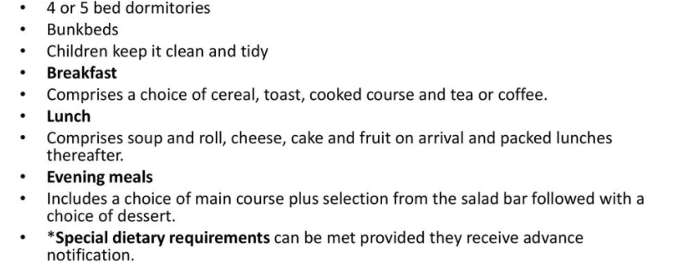
Accommodation and meals

Slide 6

Sweets, treats and teddy bears!
A small bag of sweets for the trip in a small tub is optional.
Lunch for day one only
Can't sleep without a teddy bear? Please bring him/her along.

Slide 7
Activities
A variety of activities will be available but many of these are weather dependent. There will also be an activity each night.
Rock climbing
Gorge walking
Canoeing
Raft building
Scrabbling on Barmouth slabs
Night walks
Night line

Slide 8
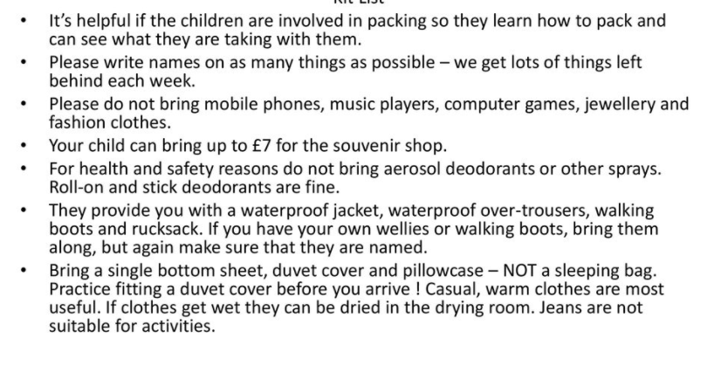
Kit List
£10

Slide 9
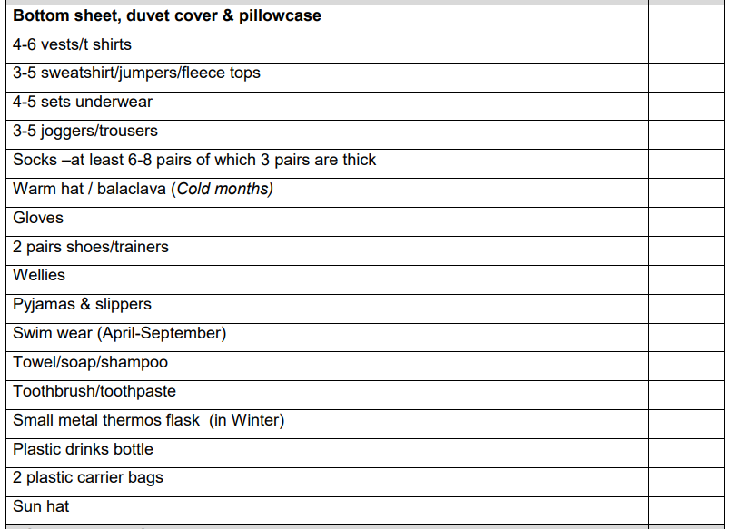
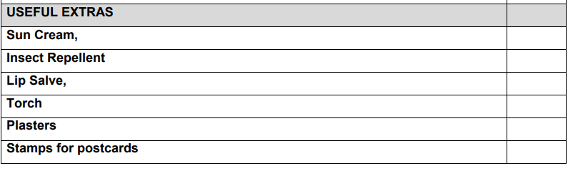
Kit List
This is the list for a 5 day trip to Arthog.
Please adapt for the 3 days that we are going.
Also this is also weather dependent so take this into account!

Slide 10

How can you help your child prepare?
Putting on a duvet challenge!

Slide 11
Medication
Any medication that your child may need during the weekend, including travel sickness tablets, must be handed to class teachers using the correct school medication form.
The medication must be in a transparent bag that is clearly labelled with the medical form.
On the form it must be detailed:
  When the medication is to be given;
  How much medication is to be given;
  Who is to give the medication.

Slide 12
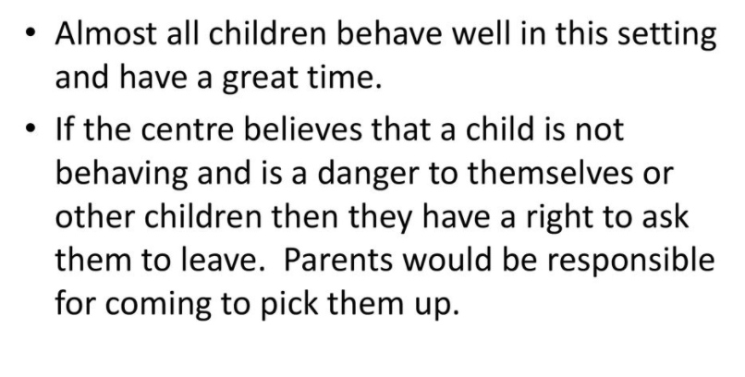
Behaviour

Slide 13
Communication
There will be limited communication from school during the residential and no communication directly from your children during our residential due to there being NO mobile phones to be taken by the children under ANY circumstances.
Each evening, we will try to update the school website with photos of our day.
If there is any need at all, the teachers will contact parents and so please ensure your most up-to-date mobile phone numbers are on the forms that you filled in last month and they are with you at all times whilst we are away.

Slide 14
Please take away with you today:
A medical form (if needed)

Slide 15
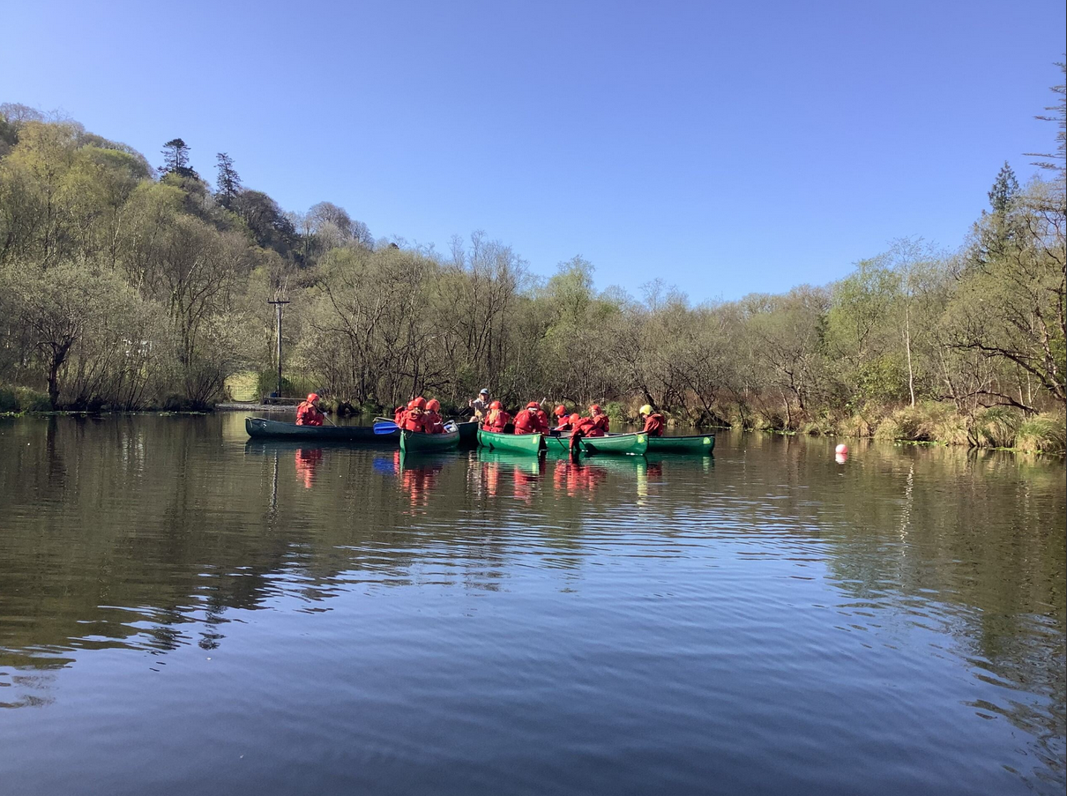
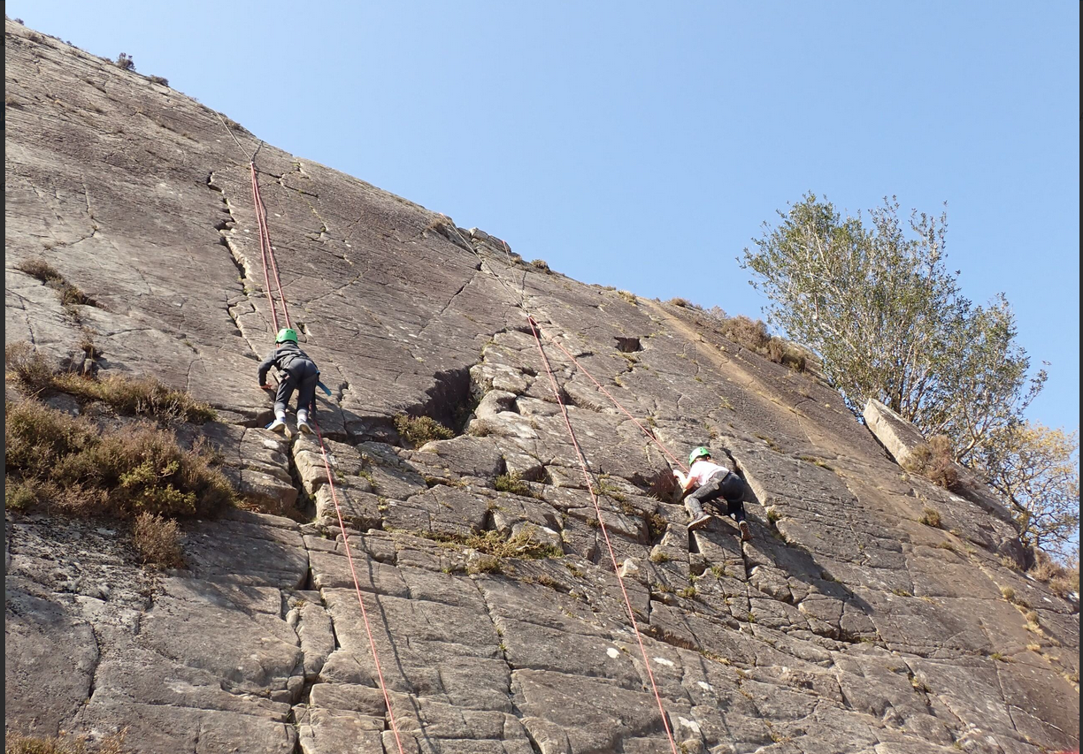
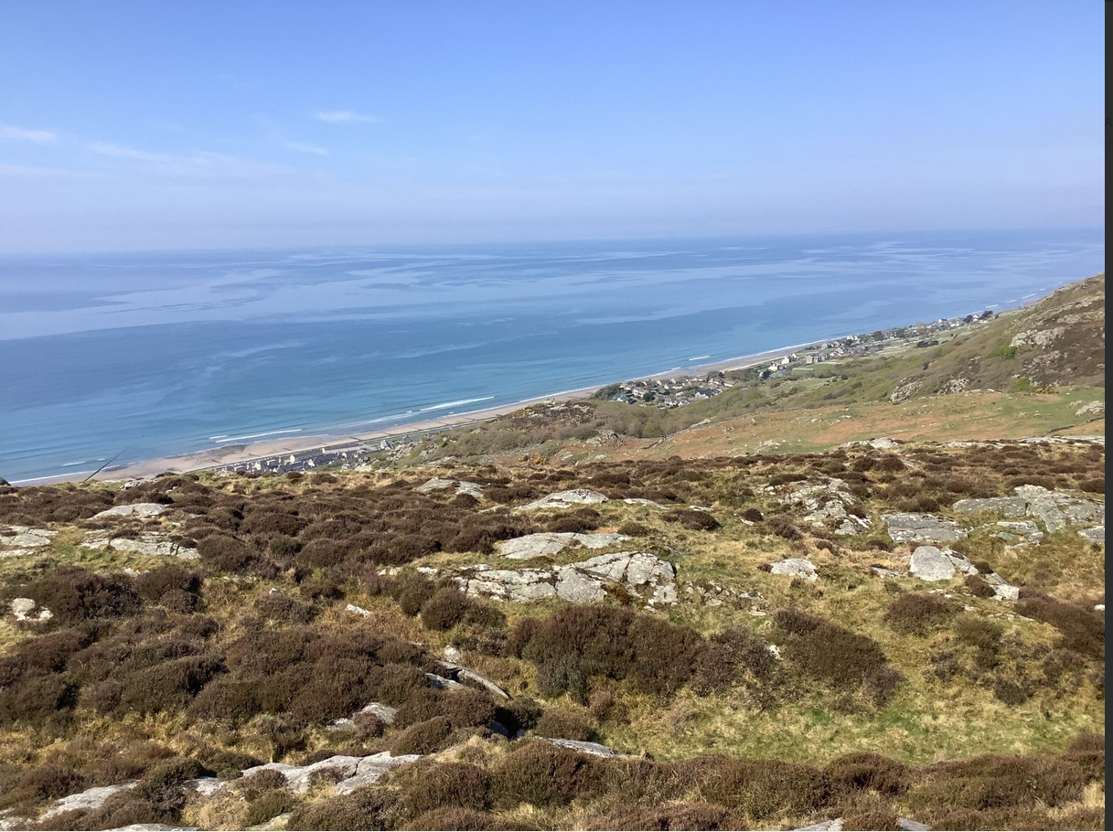
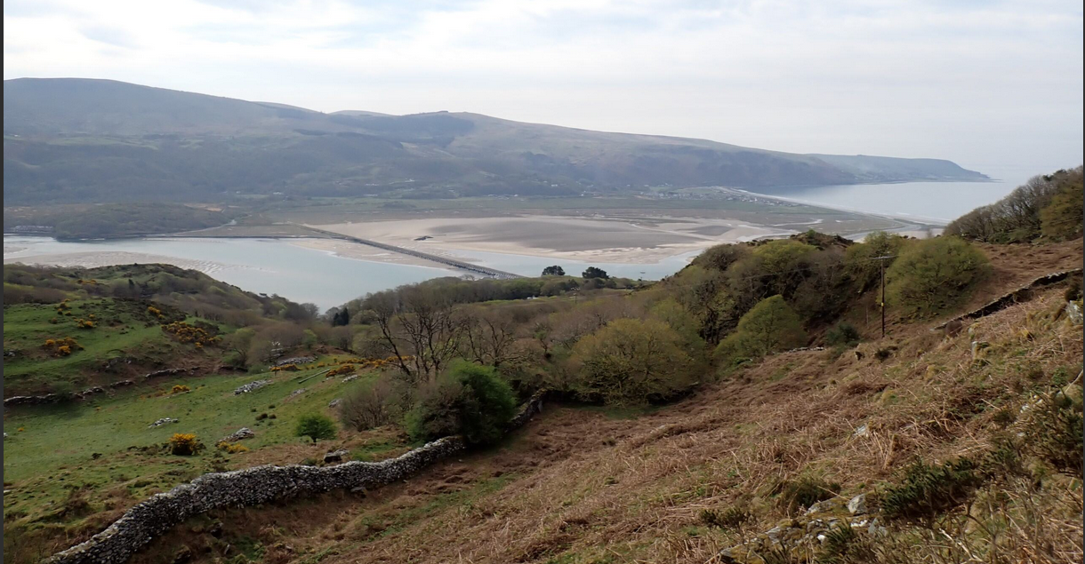
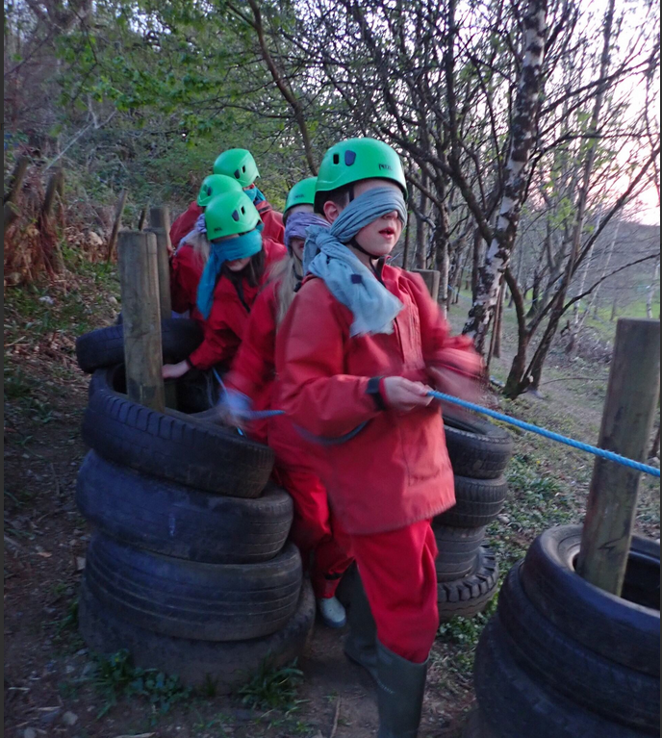
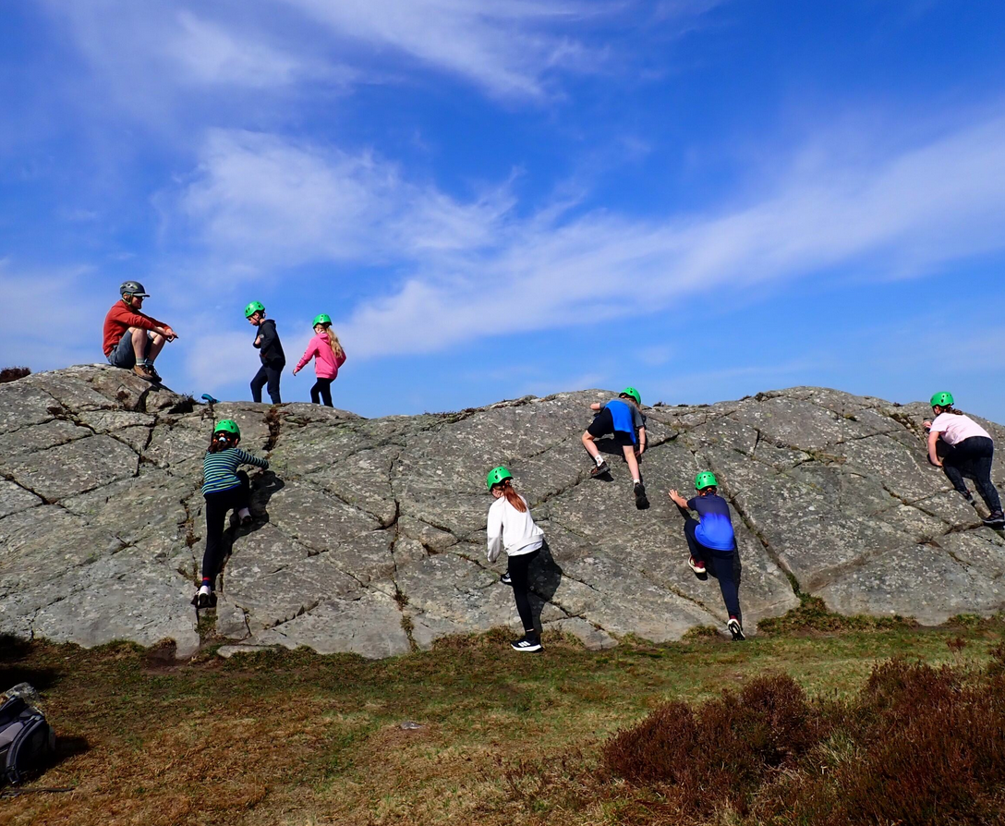
Arthog April 2025

Slide 16
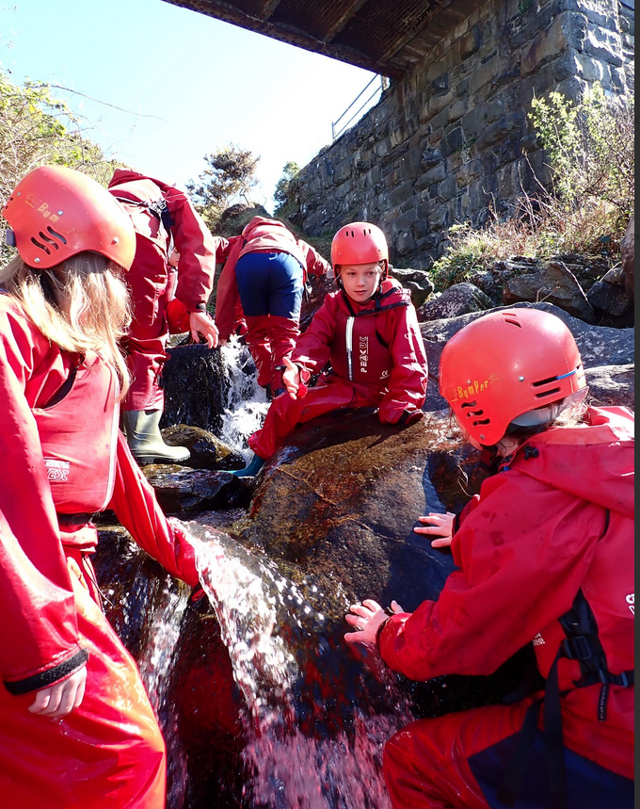
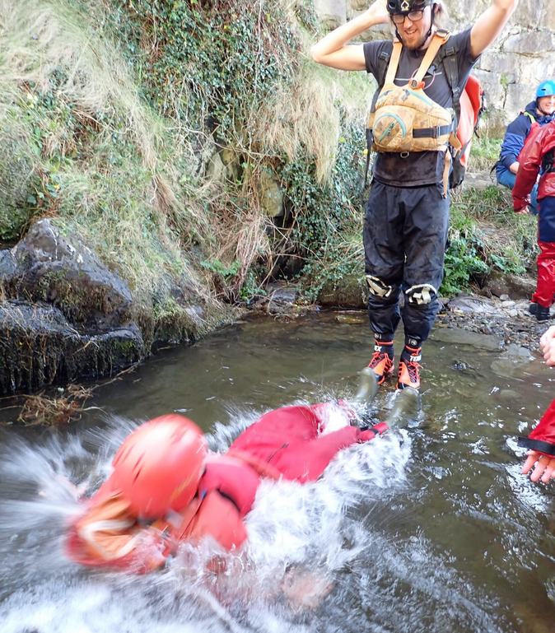
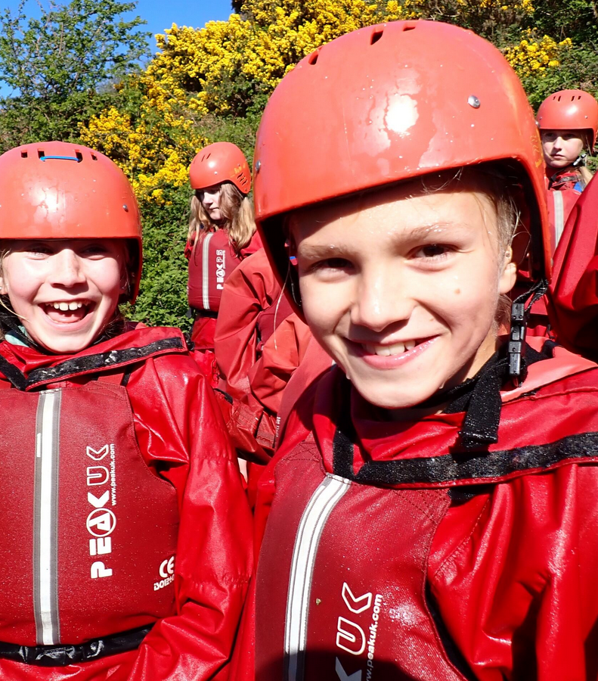
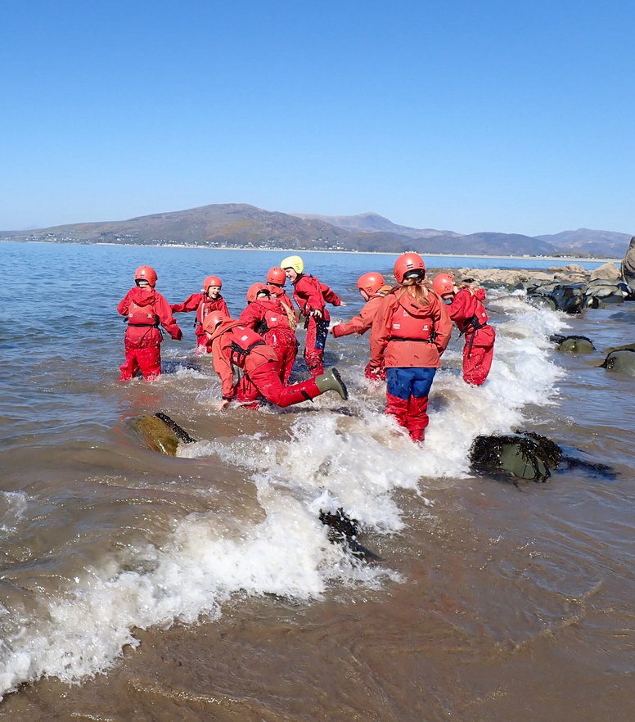
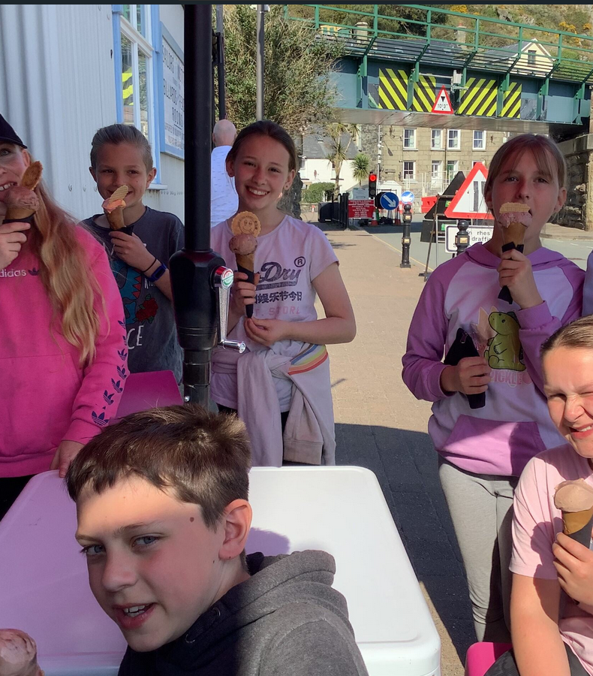
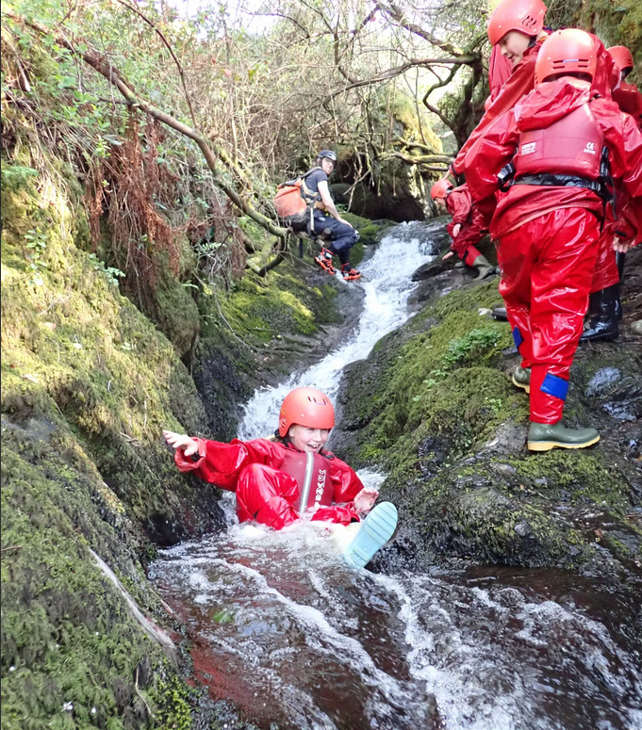
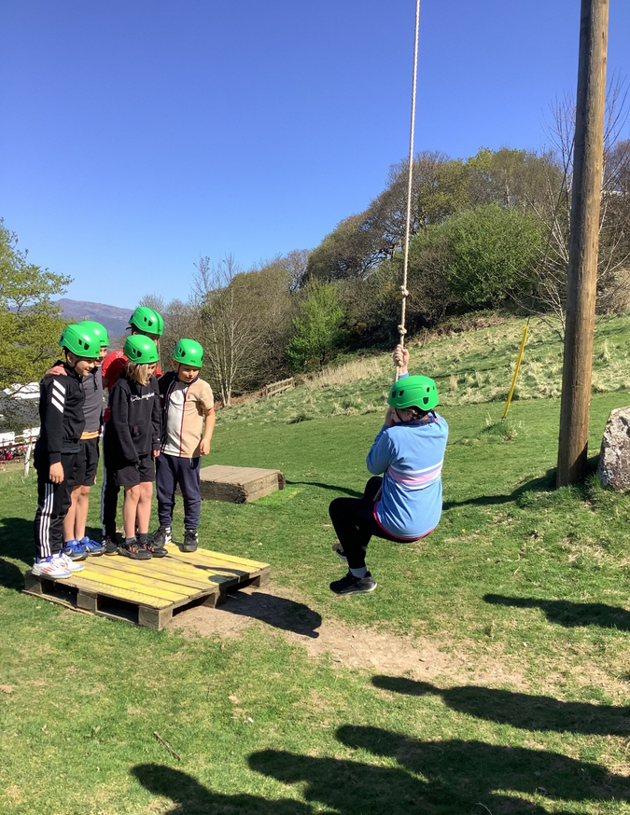
Arthog
April 2025

Slide 17
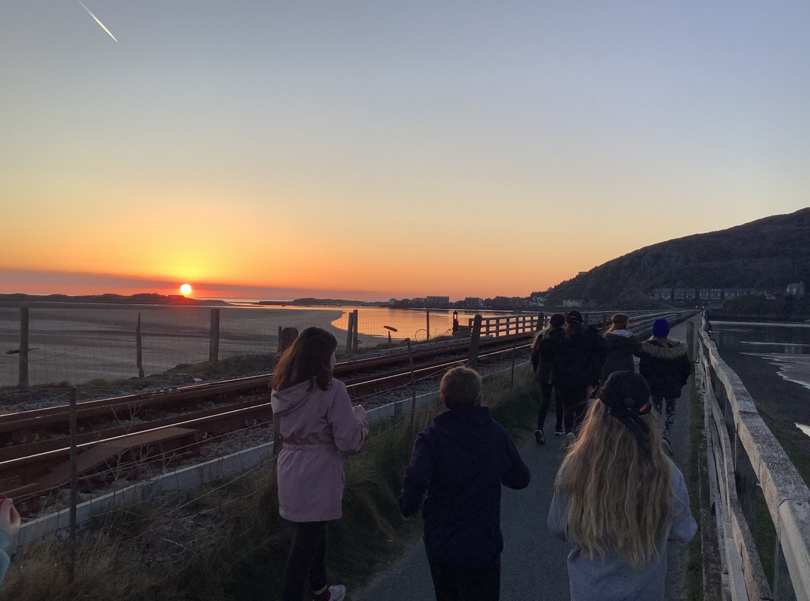
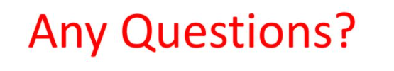
“It’s the best thing I’ve ever done!”

